Slide 1
2. Land Administration & Land policy
2.1 Definition of Land Administration
2.2 Function of Land Administration
2.3 Definition Land policy
2.4 Objective of Land Policy
2.5 Land policy instrument
2.6 Tenure security
2.7 Land market
2.8 Land use planning
2.9 land reform
2.10 Land taxation
2.11 National land policy and its objectives

Slide 2
Defining Land Administration
Land administration is the process of determining, recording & disseminating information about the ownership, value & use of land when implementing land management policy. (UN/ECE ,1996)
Process of regulating land and property development and the use and conservation of the land, gathering of revenue from the land through sales, leasing, and taxation and the resolving of conflicts concerning ownership and use of the land. (Dale & McLaughlin, 1998)
Land settlement(process of deciding which land are of state and which are of public and private), land survey, land registration, land valuation & assessment, land use control & management are key activities. (UN/ECE ,1996)

Slide 3
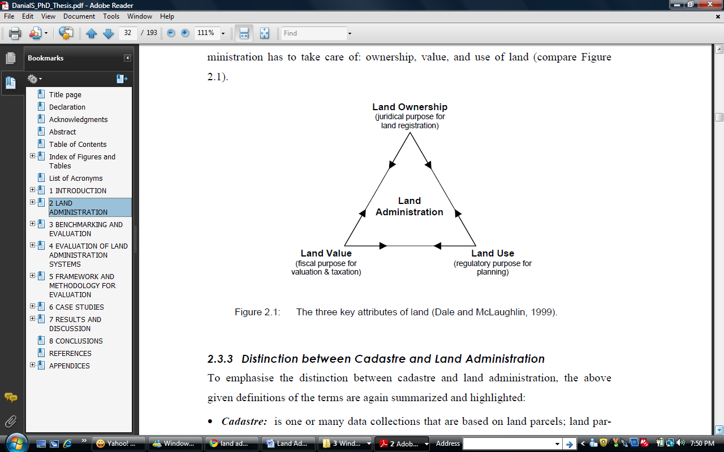
Key Attributes of Land Administration
(Dale and McLaughline)

Slide 4
Ownership
Concerned with development and use of land
Emphasis on land tax
Use
Value
Emphasis on the holding and registration of rights in land.
(Dale and McLaughlin,1999)

Slide 5
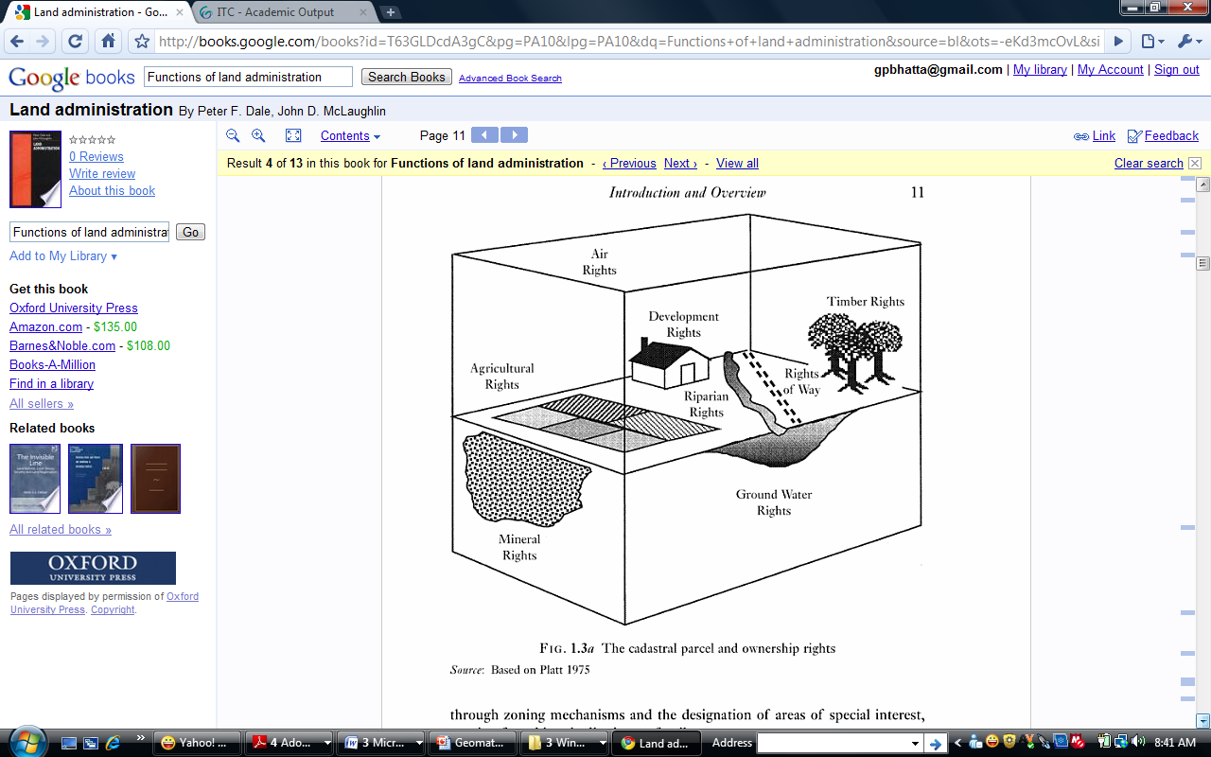
Rights to be Addressed by Land Administration
A riparian owner is the one who owns land along the bank of a river or lake or any other water body.
And certain rights enjoyed connected to the land owned by a riparian owner, are called riparian rights
Eg:
Right to use the bank or shore of a water bed
Access to and from the water
Building of structures
Swimming
Boating
Right to fishing
Right to navigation
Use of water
Protection from soil erosion
Drinking and for domestic purposes

Slide 6
Principles of Land Administration
Land Administration System (LAS)
It is the infrastructure which facilitate the implementation of land
policies, land management strategies
It is the social, legal, economic and technical framework within which land managers and administrator must operate.
Land Administrative System are concerned with mainly four administrative function of Land Tenure, Land Value, Land use, and Land development.

Slide 7
Contd..
Sustainable Development
(Economic, social and
environmental)
Effective Land Market
Effective Land Use management
Land Tenure
(Title, mortgage, easement
secure land rights)
Land Value
(Assessment of land value collection of property tax)
Land Use Policy
(Spatial Planning and control of land use)
Land Development
(Regulation and
implementation)
Land Information Infrastructure
Fig : Effective Land administrative System

Slide 8
So what Good Land administrative system does????
Guarantee ownership and security of tenure
Support land and property taxation
Provide security for credit
Develop and monitor land markets
Protect State lands
Reduce land disputes
Facilitate land reform
Improve urban planning and infrastructure development
Support environmental management
Produce statistical data

Slide 9
Contd..
2. Land Management Paradigm (Model)
conceptual framework for understanding and innovation in Land Administration

Slide 10
Contd…
3. People and Institutions
Need of the people and institutions to meet the need transparently, effectively and efficiently
4. Rights, Restrictions and Responsibilities
RRR of owners in terms of using land
5. Cadastre
Core of any Land Administration System
6. Dynamism of LAS
4 dimension
Continual evolution of people-to-land relationships,
impact of Geo-ICT and globalization,
Information within the LAS
Change in the use of Land information.
7. Processes
Processes of land administration system to manage change
8. Technology
Opportunities offered by technology to improve efficiency and effectiveness of LAS

Slide 11
Principles of Land Administration
9. Spatial Data Infrastructure
10. Measures of Success
measured by its ability to manage and administer land efficiently, effectively and at low cost

Slide 12
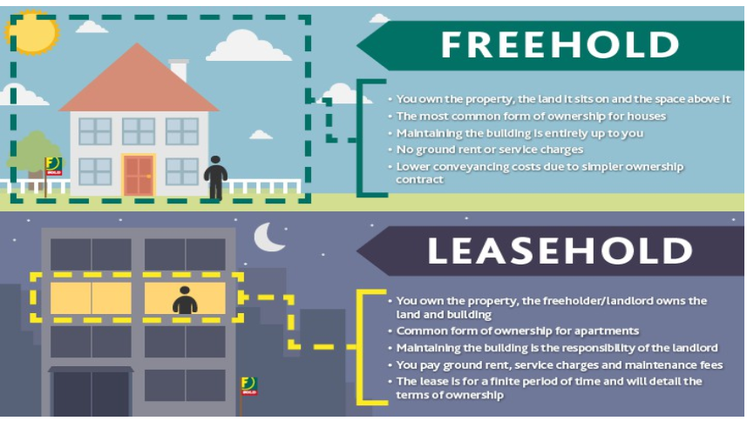
Land Rights
Use Right
Free Hold
Right of Disposal
Leasehold
Mortgage
Rent
Share Cropping
Tenancy etc..
Freehold vs leasehold

Slide 13
Use right
Ownership and long-term leaseholds are the most important rights in land
This right may be limited through public land-use regulations and restrictions, sectoral land-use provisions, and also various kinds of private land-use regulations such as easements and covenants
Many land-use rights are therefore restrictions that control the possible future use of land.

Slide 14
Freehold vs. leasehold
Freehold | Leasehold
A free tenure, distinct from leasehold, in which the owner has the maximum rights permissible within the tenure system for indefinite duration | In leasehold, the owner has less right permissible in comparison to freehold Right is exercised for definite duration
When you have a freehold property, you will have full ownership of the building and the land it stands on. | A leasehold property is different, when you purchase the lease, which gives you exclusive right to occupy the property for the duration of the lease period ( A lease is usually 99 years long but can be anything up to 999 years or even longer.) i.e Leasehold estates are for specific periods or periods that can be made specific (year to year).
 | The property right created by a lease, which is a contract by a landlord (the lessor) giving exclusive possession to a tenant (the lessee) for an agreed amount of money for an agreed period of time.
The payment would be in bulk if the property is bought and after the transfer of ownership, there is no extra payment needed. | The payment at the time a property is leased would be extra if the lease period increases.
If a person has ownership over a property, he/she does not have to pay rents to anyone other than the tax-related to it. | For a leased property, there are different sorts of rents that are unavoidable such as ground rent, maintenance fees, and much more.

Slide 15
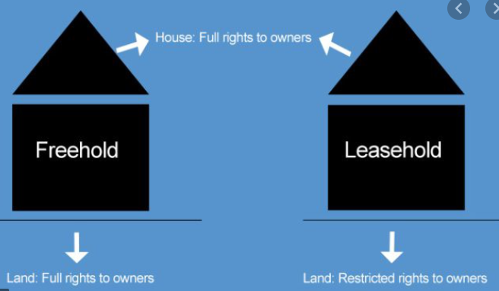

Slide 16
Contd…
Leasehold (including rental arrangements)
An owner (including the state) can allow a person or entity to have possession of land, an apartment, or even a room, for a specific time (fixed term) or a time that can be fixed (for life).
The periods are variable, depending on the needs of the parties. The owner retains a reversion that entitles him or her to possession at the end of the term and, meanwhile, to rents or other services from the lessee.

Slide 17
Contd…..
Rent
Rent refers to the mode of payment that is either done under Lease or under a small rental agreement between two parties
i.e. Landlord and Tenant for using a property for a small period.
for short period of time
involve regular payment for using the assests
Flexible can be changed before the expiration of the agreement.
extension depends on owners decision

Slide 18


Contd…
Fig : Sale by owner
Fig : Rent

Slide 19
What is Land Policy???
Land management involves the implementation of fundamental policy decisions about the nature and extent of investments in the land
It thus involves routine operational decisions made each day by land administrators such as surveyors, valuers, and land registrars.
From an institutional perspective, land management includes the formulation of land policy, the legal framework, resource management, land administration arrangements, and land information management.

Slide 20
Contd…..
‘’Land Policy consists of the complex legal and socio economic prescriptions that dictate how the land and the benefits from the land are to be allocated’’
(page 47 Land Administration Guidelines, 1996)
‘’The rules governing access to and the distribution of the benefits from one of the economy’s main assets’’
(Page 178 Deininger 2003)
A balance must be struck between the utilization and conservation of the land as a resource in order to obtain the necessary level of sustainable development for the survival of humankind
Notes:
Source
Land Administration Guidelines of the UN/ECE/Working Party on Land Administration, New York, Geneva 1996, in ITC Library and also to be accessed at http://www.unece.org/hlm/wpla/publications/laguidelines.html
We take this definition as a good one, as it recognizes that the land issue comprises both social, economical and legal measures, to allocate benefits, not only in the sense of access to land as such, but also access to land related benefits. Ac land policy might be a policy at various levels of government, in our view also including the ‘land policy’ of traditional authorities (also called ‘existing institutions’) in customary areas. It refers also to the ‘allocation’ question: will access to land and land –related benefits only be allocated to the powerful elites, the political interests, the ‘rich’? Or also to the poor, both in urban and rural areas, only to large-holders, or also to small-holders, only to international companies, or also to the local middle and small size firms, only to the members of a certain ethnic group, to the State, the President or to all citizens? This makes the land issue a highly political issue, as allocation comprises choices about the distribution of scarce resources. One might even say that there is an ideological aspect. Choices are different when taken in a capitalistic, socialistic or communist political environment.

Slide 21
Land Policy in the Political Context
The goal defined by a politician or a political party created with data, information, facts, research, statistics and intelligence to communicate the collective choices, decisions, voices and priorities of their constituency or electorate.
Notes:
This is another definition, as can be read on page 178 of the World Bank Policy Research Report ‘Land Policies for Growth and Poverty Reduction’, written by dr. Klaus Deininger, Oxford University Press 2003 (in ITC Library), which also can be accessed at:
http://econ.worldbank.org/WBSITE/EXTERNAL/EXTMODELSITE/EXTPRRMODEL/0,,ImgPagePK:64202988~entityID:000094946_0307250400474~pagePK:64212652~piPK:64212659~theSitePK:477757,00.html
This Report is the basis for Module 8, because it formulates new insights in land policy matters, based on an impressive body of research.
We refer to this book as ‘ibid, Deininger, 2003, page >>>’.
The last public announcement by the World Bank on land issues, was in 1975 (the Land Reform Policy Paper, in OICRF). This paper however dedicated little attention to the importance of land rights for the empowerment of the poor and improving local govenance, private sector outside agriculture, gender and eauitisy aspects, and the good use of rural and urban lands (see ibid. Deininger, 2003, page xliv-xlv of it’s summary, in ITC Library). Compared with the definition of ‘land policy’ from the Land Administration Guiudelines, we might say that both are similar. Both definitions provide a good starting point for this lecture.

Slide 22
Need for a Land Policy?
Land is a key-assets for the rural and urban people (especially economically poor people)
Land provides a foundation for economic activity and the functioning of market- and non-market institutions (empowers households and government)
Allocation of land and it’s benefits influence economic growth and poverty eradication
Control of land is a major source of political power, so empowers the poor
Systematic distortions of land and ethnicity leads to conflict and violence, so avoids social unrest
Existence of multiple market-imperfections, so interventions necessary
Notes:
Why is a land policy needed? We refer here to (ibid. Deininger, 2003, pages xvii-xxi and 178-190, in ITC Library). Important is that research shows that property rights and proper land use play an important role to enhance economic growth and poverty eradication, but that this does not come spontaneously, because there are multiple market imperfections. For example: in the land market not everyone has the same chances to accessing land, the market is imperfect. With other words: the government should intervene in how society develops, through the formulation of a set of market- and non-market interventions in such a way that the higher objectives are met. Research shows (see ibid Deininger, 2003, page xix) that such interventions also may be poorly designed, resulting in a situation worse than before. So designing a land policy is a critical and careful process (ibid. Deininger, 2003, page 183-184).

Slide 23
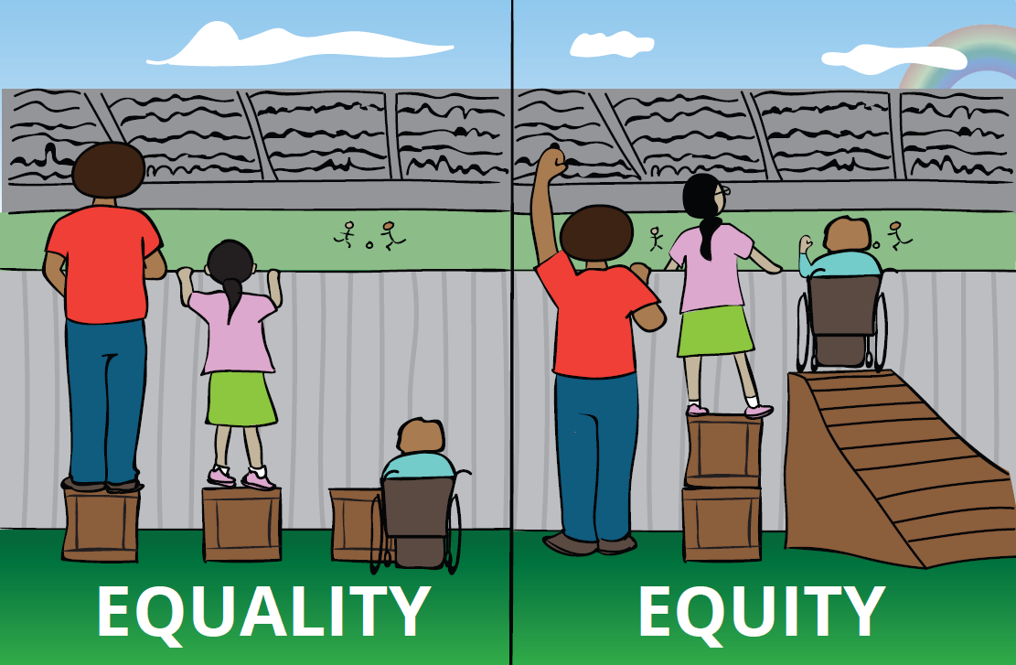
???

Slide 24
Land Policy Principles
Land Policy Principles address the essential values, which the society seeks to promote and preserve. They include:
a) Equitable access to land;
b) Secure land ownership;
c) Effective regulation of land development;
d) Sustainable land use;
e) Access to land information;
f) Efficient land management;
g) Vibrant or functional land markets; and
h) Transparent and democratic administration of land.

Slide 25
Importance of land policy?
Economic growth - investments, credit, productivity
Poverty eradication - subsistence farming, market surplus, status
Governance -democracy, decentralization, no conflicts, accountability
Environmental Sustainability - effective land use, inclusion externalities, state land management
Notes:
The importance of land policy is that is expected to improve these 4 goals.
Economic growth is increased because secure property rights invite households to invest, open options for cheaper credit, and make them less vulnerable in case of shocks. Also a better land distribution promotes productivity, and the functioning of households in factor markets (that are the markets for land, labor and capital and/or energy, materials and services Secure land rights also makes it possible that owners rent the land out, so that they can enjoy non-agricultural employment (ibid, Deininger, 2003, page xix, in ITC Library).
Poverty eradication is increased because households can make more productive use of their land, allowing then to be less dependent of wage labor. Furthermore households can produce for their own subsistence and may be some surplus to sell, as ‘owner’ enjoy a better social status, invest, have access to financial markets. This counts especially for women. (ibid, Deininger, 2003, page xx)
Governance can be improved because households might get a ‘voice’, they don’t live outside the law, it creates the basis for participatory local development, with more accountability of local officials (ibid Deininge, 2003, page xxi)
Effective land use is encouraged when the government can take measures to bring land to higher productivity through better land markets, fair distribution of land where markets are not able to address, providing incentives for land use that brings social welfare and includes externalities (ibid Deininger , 2003, page xxxviii).

Slide 26
Content of a land policy
Increase property rights and legal security
Market interventions for both sales- and rental markets
Reduction transaction costs in the land market
Reducing the scope of bureaucratic interventions
Improving the climate for private investments
Strengthening existing (local) institutions
Ensure effective land use and bringing in line with social needs
Help landless people through land redistribution
Notes:
The body of research leads to the assumption that a good land policy says something about improving the security of property rights, while respecting various types of rights and the institutions that manage the land. Building upon existing institutions is even more recommendable as central government often fail to govern. Apart from the land sales market, equity appears to benefit more from rental markets. Government play a critical role in creating a sound market. Research shows that the contribution of a government in the sense of providing secure tenure, low transaction costs, eliminate credit market imperfections of offers safety nets for foreclosure is already a big step forward. Private investments are encouraged by secure tenure (see also the World Bank Doing Business Reports (http://www.doingbusiness.org/documents/FullReport/2008/DB08_Full_Report.pdf)
A better distribution of land ownership promotes better use and better productivity and might bring houdeholds in the formal economy ( ibid. Deininger, 2003, page186-189)

Slide 27
Land policy instrument
Tenure security
Land market
Land use planning
Land reform
Land taxation

Slide 28
Land Reform
Land reform is ‘the various processes involved in altering the pattern of land tenure (determines who can use land, for how long and under what conditions.) and land use of a specific area’ (Land Administration Guidelines, 1996, page 91).
Land administration systems are to support those various processes and to register the status of land before, during and after the land reform process.
Land reform involves the changing of laws, regulations or customs regarding land ownership

Slide 29

Types of land reform
Land redistribution
‘Transferring larger operational holdings to those with little or no land ,such as wage laborers or the landless’
Fig : Land redistribution

Slide 30
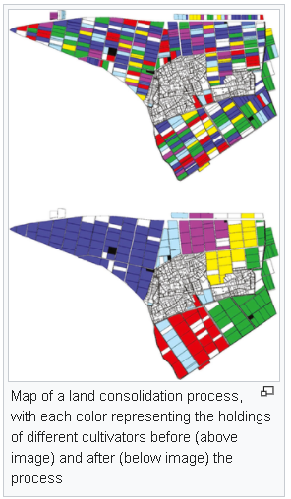
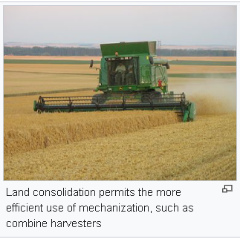
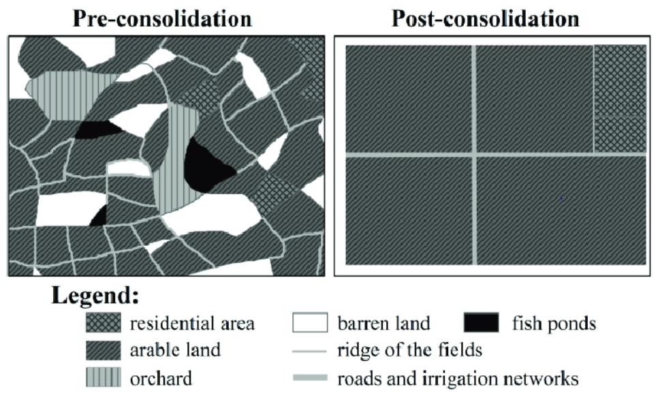
Contd….
Land consolidation
Land Consolidation is the re-allocation of farm land to make bigger farm units (Europe, Japan).
Fig :Land Consolidation

Slide 31
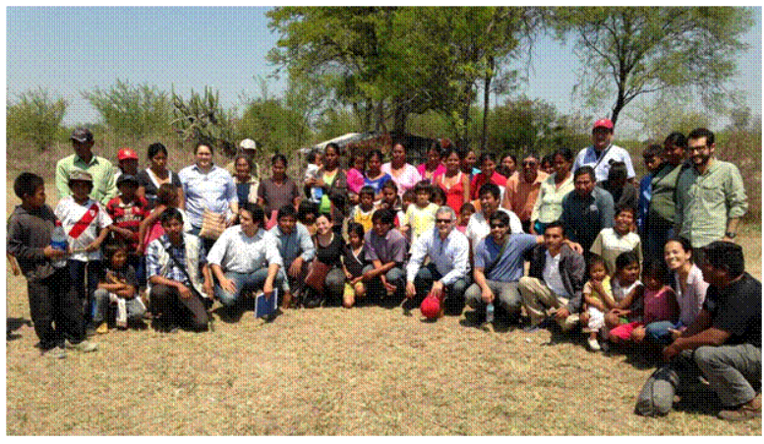

Types of Land reform
Land Restitution is conversion of expropriated land back to former rightholders (central and eastern Europe, Southern Africa, Latin america).
Fig : Land restitution program in Paraguay

Slide 32
Contd…..
Land tenure reform
‘Reforming the terms on which an operational holdings is controlled and worked ,and is attentive to those aspects of tenure which are thought to affect incentives ,investment and efficiency’
Agrarian collectivization is conversion of private farms into state farms (Mozambique, Angola, Ethiopia, central and eastern Europe).
Land Nationalization is bringing land ownership under the State of President (some African countries, former central and eastern Europe, China, former Vietnam and Cambodia).
Land Fragmentation is dividing larger portion of land into small parcel. It is the breaking up of areas of natural habitat(forest).

Slide 33
Land reform issue in Nepal
Land rights advocacy and movement in Nepal defines land rights as establishment of the rights of the actual tillers over the land. Any person who possesses, or earns livelihood out of the land is entitled to acquire the ownership title over the land
After the downfall of Rana regime, the concern was to bring back to government the ownership the land unjustly distributed to elite families in the form of grants
Forest Nationalization Act 1957
. Because of the exploitative policies of the state before 1950, a large part of forest, mainly in Terai, was given as grants to few families of the powerful groups

Slide 34
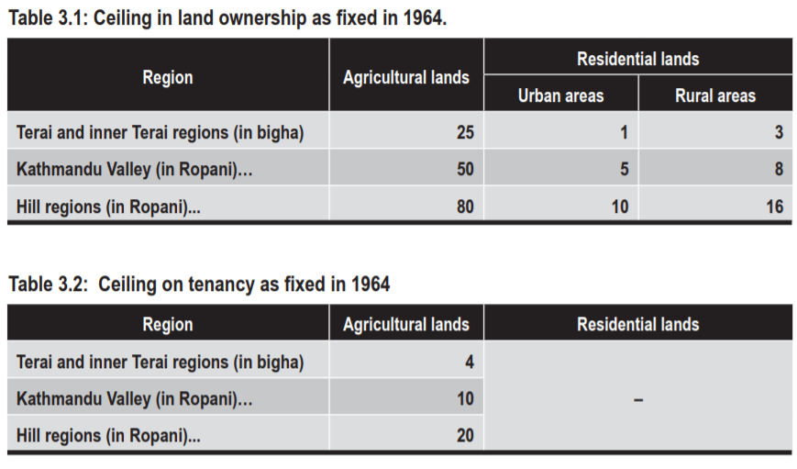
Contd…
enactment of Land Related Act 1964 and its implementation during the period of Panchyaat System

Slide 35
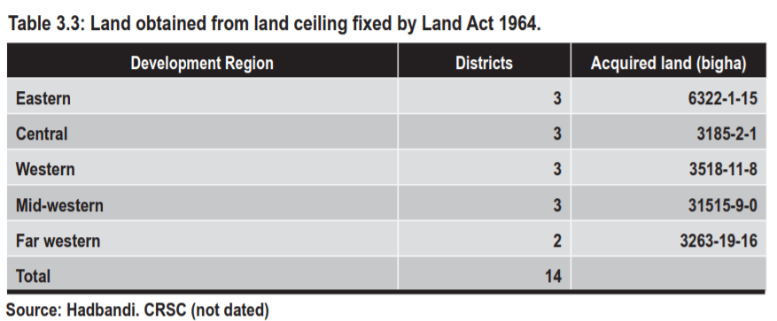
Contd….
Until 1964, the Zamindari system of collecting the land revenue and allocating the land for cultivation was in practice. Under this system, the Zamindars (landlords) used to collect land revenue from other holders on behalf of the government. This system was also abolished in 1964.

Slide 36
Contd….
Badal commission
After abolishing the ‘dual ownership’ on land in 1996, government initiated ‘land bank’ policy, which is considered as ‘market-led’ land reform program, which aims to match ‘willing sellers and willing buyers’, and provides credit, payable in 15 years, to poor landless and marginal farmers to buy land. It was implemented since 2005. This was also supported by World Bank.
But it was also not be able to address other fundamental land related problems such as tenancy rights of unregistered tenants or acquiring land above ceiling or land fragmentation, etc. After the 2006 political change, this program was formally stopped.

Slide 37
Other law associated to land affecting land reform
Land Acquisition Act, 1977
acquiring private lands for the purpose of public use.
Birta Abolition Act, 1959
abolished all individual rights on Birta forests and lands, and nationalized them without paying any compensation to the previous owners.
Land Revenue Act, 1977
to collect effectively land revenues from the cultivable land
Trust Corporation (Guthi) Act 1976
Land Survey and Measurement Act, 1962
Range Land( grasslands, shrublands, woodlands, wetlands) Nationalization Act, 1974
to nationalize the rangeland for the economic interest of the people of Nepal.

Slide 38
Contd….
Agriculture Perspective Plan (1995-2015)
Agricultural Policy 2004
Note : also go through Land Reform in Nepal by

Slide 39
Land market
What is a market? = any situation whether formal or informal where buyers and sellers are brought together to fix a price (based on demand and supply) at which goods and services can be exchanged.
A market in rights to land
Land Rights as a commodity

Slide 40
Which facilitators of the land market?
Notary Public: drawing up legal documents
Private conveyancers: assisting buyers and sellers in making contract of sales
Real estate agents (brokers): bringing together supply and demand
Valuers, appraisers, assessors: estimating the value of property
Banks: providing credit
Land administrators: providing land tenure security and land information

Slide 41
Which players in the land market?
Buyers and sellers: supply and demand
Government - market policy: restrictions, subsidy, - social housing: rental market - spatial planning: allocation - fiscal policy: taxation and tax deductibility
Housing corporations: market rented houses
Real estate developers: market property development

Slide 42
Land Market Imperfections
Difficulty to prove evidence of ownership
Unequal access to information
High transaction costs
Bureaucratic procedures
Planning and public acquisition

Slide 43
Modelling the land market: three pillar model
land market
PILLAR: Financial services
PILLAR: Land Registry & Cadastre
PILLAR: Land valuation
policy framework & legal basis

Slide 44
Three Pillar Model

Slide 45
Three pillars of the land market
Connection land and people (by land administration systems)
Connection land and value (by estimating value of the asset)
Connection money and people (by financial services)

Slide 46
The link between the land market and land administration
Land administration one out of three pillars of the land market - sound legal basis for ownership and trading of property rights - legal structures in place, including inheritance - recording and registration systems are soundly implemented - land and buildings can be traded and leased easily - quality of land information data is good
Land administration contributes to the other two pillars - supports valuation pillar (comparing market prices) - supports financial services pillar (securing mortgages, and taxation)

